Slide 1
Investment Research for Business Establishment of Restaurant
Yiğit Büyükboyacı
28.04.2021

Slide 2
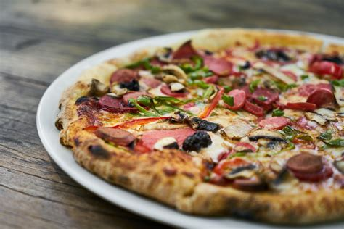
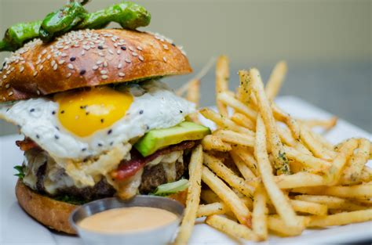
A. Introduction
What is the best place for opening burger or pizza restaurant in the İzmir/Konak ?
What is the categories of pizza restaurant ?
What is the categories of burger restaurant?

Slide 3
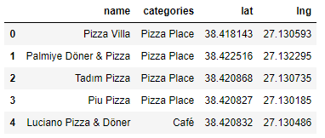
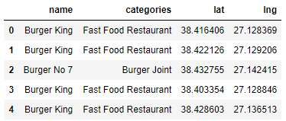
Data of Pizza Restaurant and Burger Restaurant
In total 49 Pizza Restaurant was found in Konak.
In total 29 Burger Restaurant was found in Konak

Slide 4
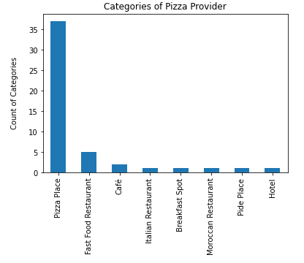
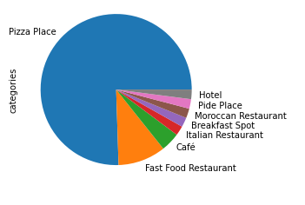
Categorical Data of Pizza Provider

Slide 5
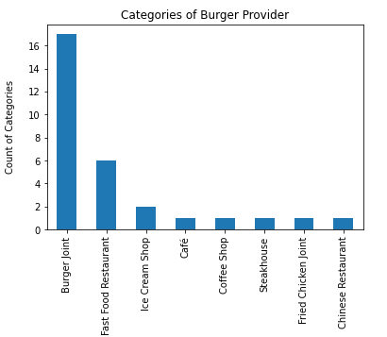
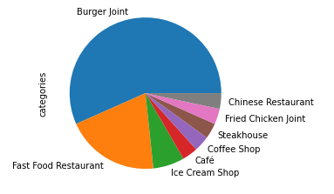
Categorical Data of Burger Provider

Slide 6
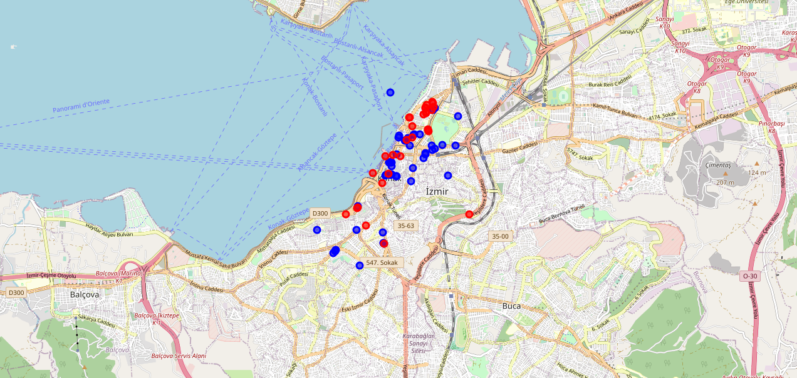
Visualizes of geographic data

Slide 7
Conclusion
As a conclusion according to our customer request middle side of Konak will be best location in order to set up new pizza restaurant. Thus competition will be increase and our customer's profitability will increase in the market.

